Slide 1
Software Requirements Engineering
Engr. Sara Rehmat

Slide 2
3. Business context
Stakeholder profiles
Project Priorities
Deployment Considerations

Slide 3
3.1 Stakeholder profiles
The stakeholder profiles describe different categories of customers and other key stakeholders for the project.
Each stakeholder profile should include the following information:
The major value or benefit that the stakeholder will receive from the product. Stakeholder value could be defined in terms of:
Improved productivity.
Reduced rework and waste.
Cost savings.
Streamlined business processes.
Automation of previously manual tasks.
Ability to perform entirely new tasks.
Compliance with pertinent standards or regulations.
Improved usability compared to current products
Their likely attitudes toward the product.
Major features and characteristics of interest.
Any known constraints that must be accommodated.

Slide 4
3.2 Project priorities
To enable effective decision making, the stakeholders must agree on the project’s priorities.
One way to approach this is to consider the five dimensions of features, quality, schedule, cost, and staff
Each dimension fits in one of the following three categories on any given project:
Constraint A limiting factor within which the project manager must operate
Driver A significant success objective with limited flexibility for adjustment
Degree of freedom A factor that the project manager has some latitude to adjust and balance against the other dimensions

Slide 5
3.3 Deployment Considerations
Summarize the information and activities that are needed to ensure an effective deployment of the solution into its operating environment.
Describe the access that users will require to use the system, such as whether the users are distributed over multiple time zones or located close to each other. State when the users in various locations need to access the system.
If infrastructure changes are needed to support the software’s need for capacity, network access, data storage, or data migration, describe those changes.
Record any information that will be needed by people who will be preparing training or modifying business processes in conjunction with deployment of the new solution.

Slide 6
Scope Representation Techniques
The models described in this section can be used to represent project scope in various ways.
You don’t need to create all of these models; consider which ones provide the most useful insight for each project.

Slide 7
Context Diagrams
The context diagram visually illustrates scope i.e. the boundary between the system you’re developing and everything else in the universe.
It identifies external entities (also called terminators) outside the system that interface to it in some way, as well as data, control, and material flows between the terminators and the system.

Slide 8
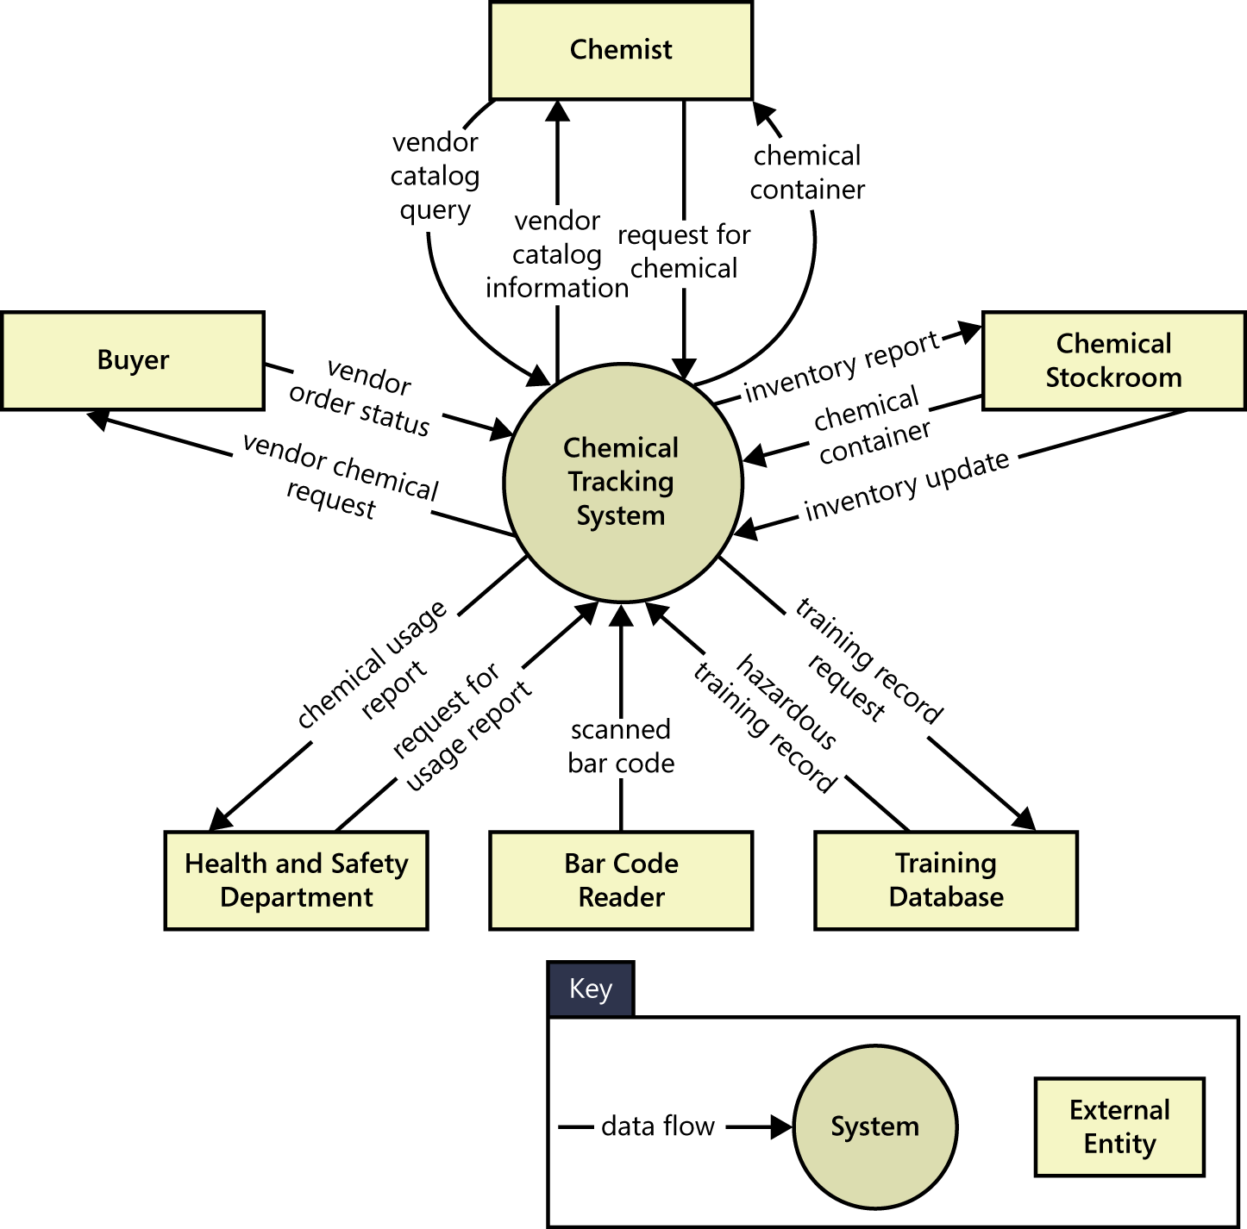

Slide 9
Ecosystem map
An ecosystem map shows all of the systems related to the system of interest that interact with one another and the nature of those interactions.
An ecosystem map represents scope by showing all the systems that interconnect and that therefore might need to be modified to accommodate your new system.
Ecosystem maps differ from context diagrams in that they show other systems that have a relationship with the system you’re working on, including those without direct interfaces.
You can identify the affected systems by determining which ones consume data from your system. When you reach the point that your project does not affect any additional data, you’ve identified the scope boundary of systems that participate in the solution.

Slide 10
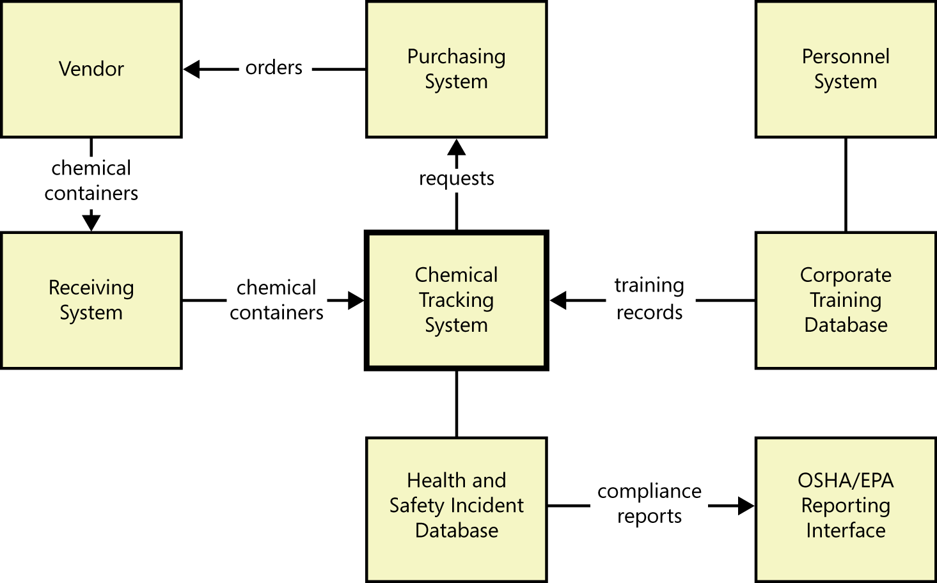

Slide 11
Feature Tree
A feature tree is a visual depiction of the product’s features organized in logical groups, hierarchically subdividing each feature into further levels of detail.

Slide 12
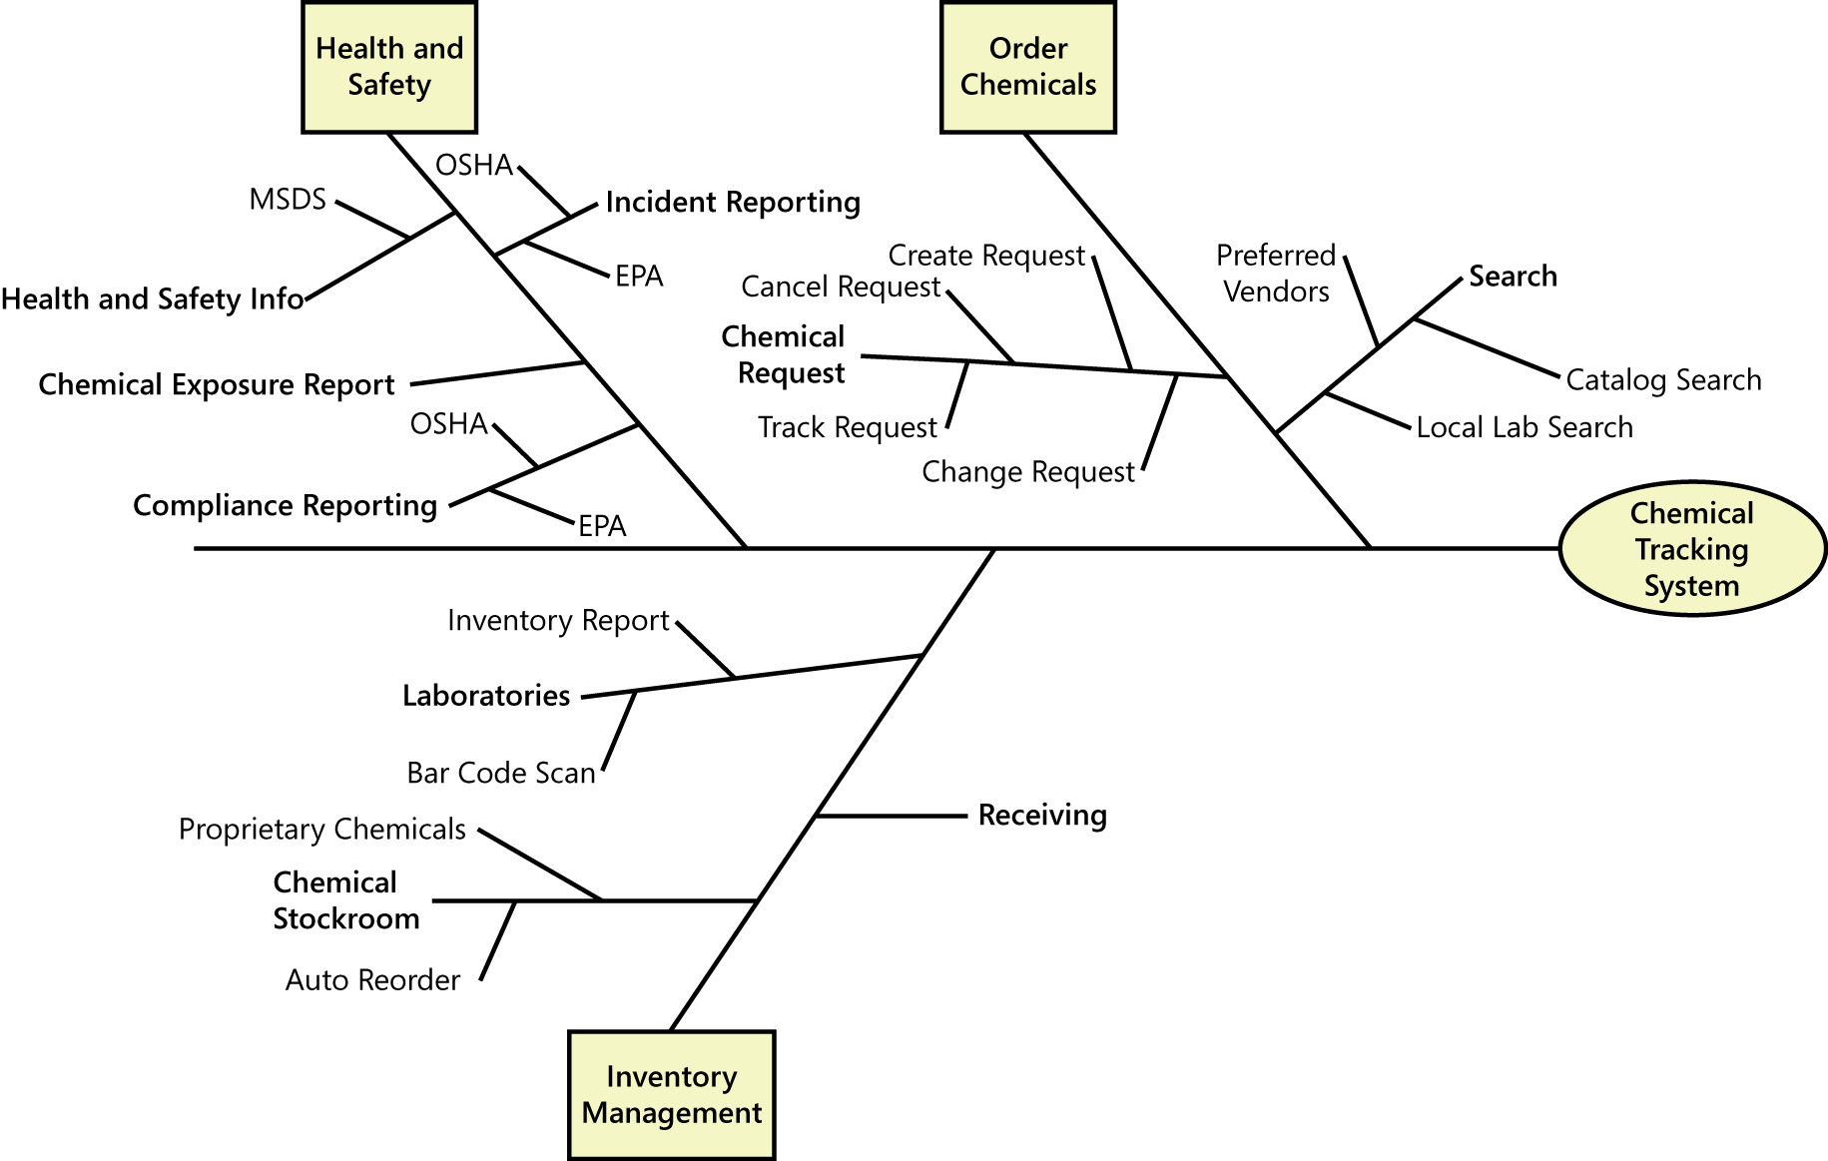

Slide 13
Feature Tree
When planning a release or an iteration, you can define its scope by selecting a specific set of features and subfeatures to be implemented.
You could implement a feature in its entirety in a specific release, or you could implement only a portion of it by choosing just certain L2 and L3 subfeatures.
Future releases could enrich these rudimentary implementations by adding more L2 and L3 subfeatures until each feature is fully implemented in the final product.

Slide 14
Event list
An event list identifies external events that could trigger behavior in the system.
The event list depicts the scope boundary for the system by naming possible business events which are
triggered by users,
time-triggered (temporal) events,
signal events received from external components, such as hardware devices.
The event list only names the events; the functional requirements that describe how the system responds to the events would be detailed in the SRS by using event-response tables.

Slide 15
An event list is a useful scoping tool because you can allocate certain events to be implemented in specific product releases or development iterations.

